Slide 1
Ethanol Concentration Prediction in Syngas Fermentation
CIS 732/830 Final Project
Ying Tan | K-State Theme Edition
Kansas State University | CIS 732/830 | Title

Slide 2
Dataset: 176 samples, 7 features, target = ethanol (mM)
RF test: RMSE=4.3706, MAE=3.0850, R2=0.9529 (best)
MLP test: RMSE=5.5337, MAE=4.0084, R2=0.9245
LR test: RMSE=12.1832, MAE=9.2922, R2=0.6340
Statistical tests: paired t-test p=2.79e-06, Wilcoxon p=3.02e-06
Slides 3-15 cover Figure 1 to Figure 13 with explanations.
Kansas State University | CIS 732/830 | Overview

Slide 3
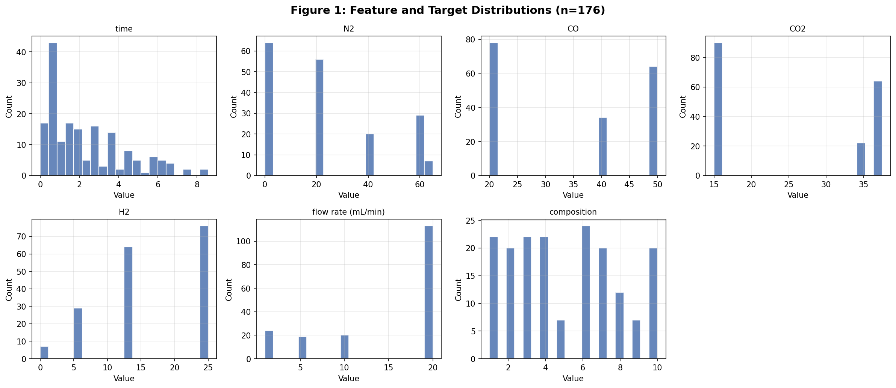
Figure 1: Data Distributions
- Shows spread/skewness of all features and target.
- Confirms heterogeneous feature scales.
- Supports preprocessing and scaling decisions.
All values and figures are generated from scripts/syngas_analysis.py
Kansas State University | CIS 732/830 | Figure

Slide 4
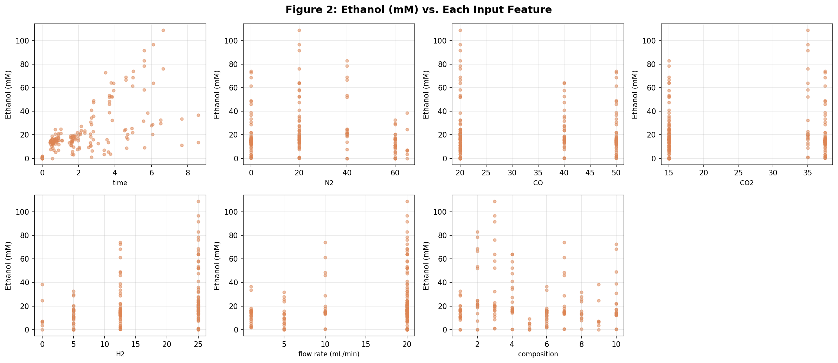
Figure 2: Feature vs Target
- Visual evidence of nonlinear relationships.
- Motivates RF/MLP beyond linear baseline.
- Helps identify interaction effects.
All values and figures are generated from scripts/syngas_analysis.py
Kansas State University | CIS 732/830 | Figure

Slide 5
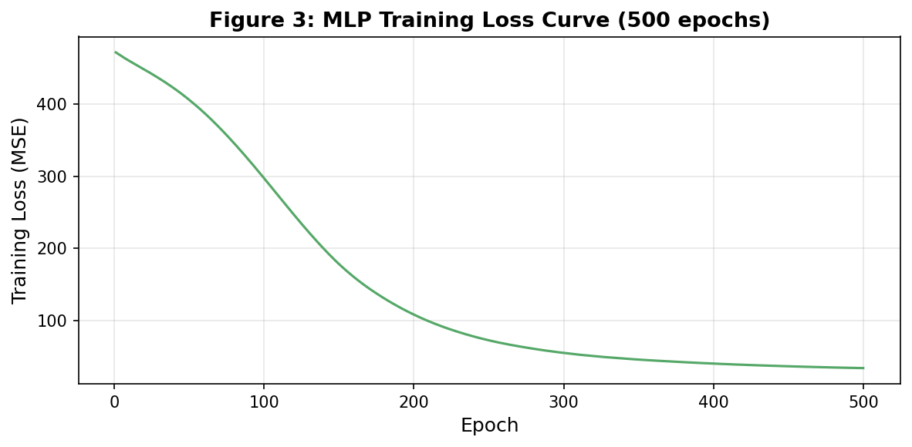
Figure 3: MLP Training Loss Curve
- Tracks optimization behavior across epochs.
- Shows convergence trend and sensitivity.
- Used for training-dynamics discussion.
All values and figures are generated from scripts/syngas_analysis.py
Kansas State University | CIS 732/830 | Figure

Slide 6
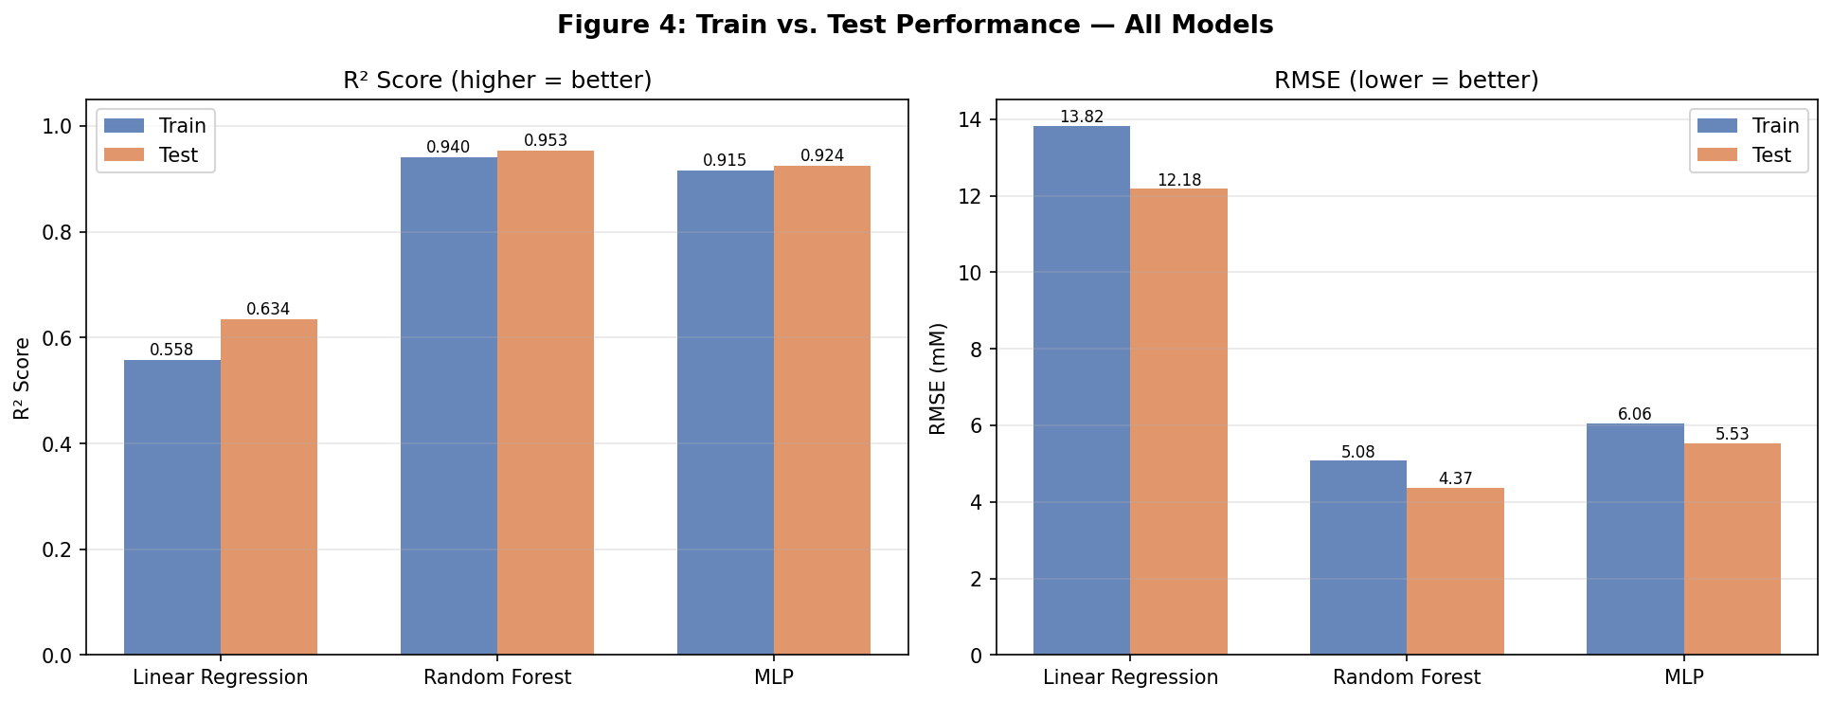
Figure 4: Train vs Test Performance
- Compares generalization across LR/RF/MLP.
- RF has strongest test metrics.
- Useful for overfit/underfit diagnosis.
All values and figures are generated from scripts/syngas_analysis.py
Kansas State University | CIS 732/830 | Figure

Slide 7
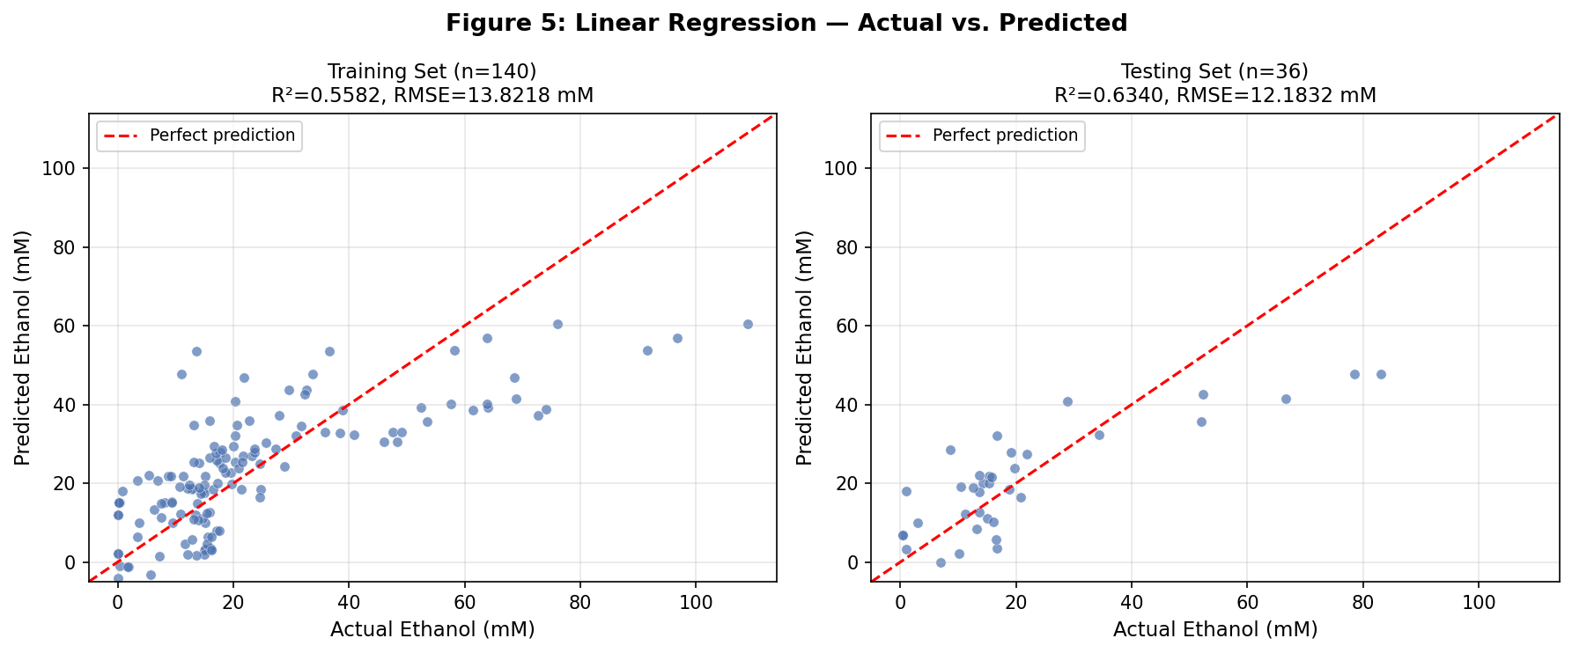
Figure 5: LR Actual vs Predicted
- Baseline behavior on train/test splits.
- Larger deviation from diagonal than RF/MLP.
- Reference for significance tests.
All values and figures are generated from scripts/syngas_analysis.py
Kansas State University | CIS 732/830 | Figure

Slide 8
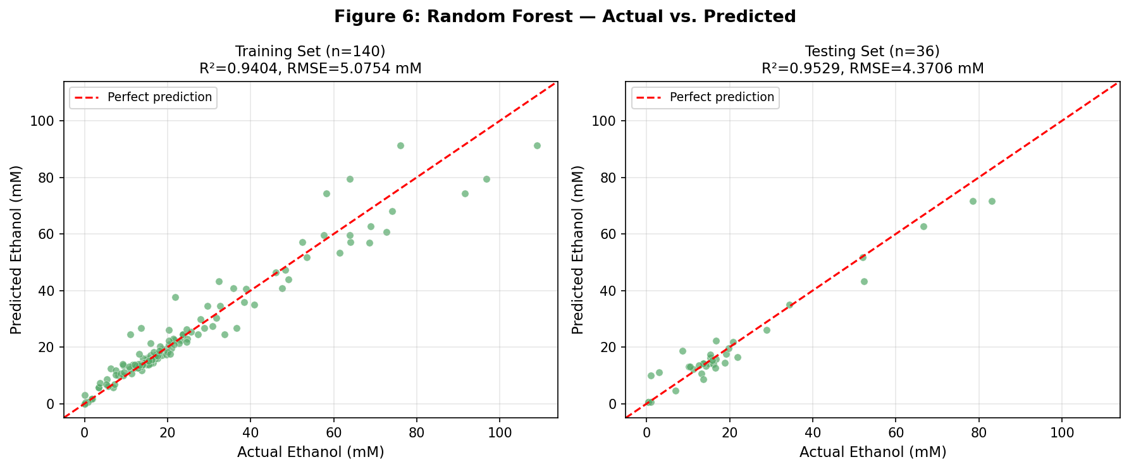
Figure 6: RF Actual vs Predicted
- Predictions cluster close to diagonal.
- Best test performance among compared models.
- Primary deployment candidate evidence.
All values and figures are generated from scripts/syngas_analysis.py
Kansas State University | CIS 732/830 | Figure

Slide 9
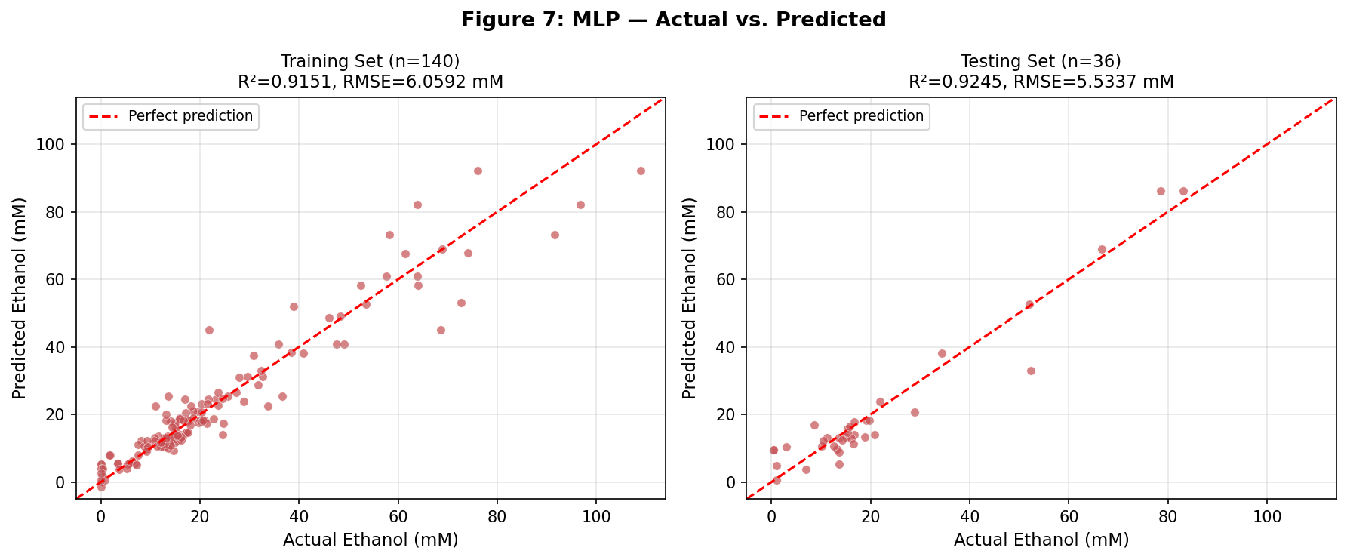
Figure 7: MLP Actual vs Predicted
- Nonlinear fit is competitive with RF.
- Sensitivity appears higher than RF.
- Interpreted with scaling ablation results.
All values and figures are generated from scripts/syngas_analysis.py
Kansas State University | CIS 732/830 | Figure

Slide 10
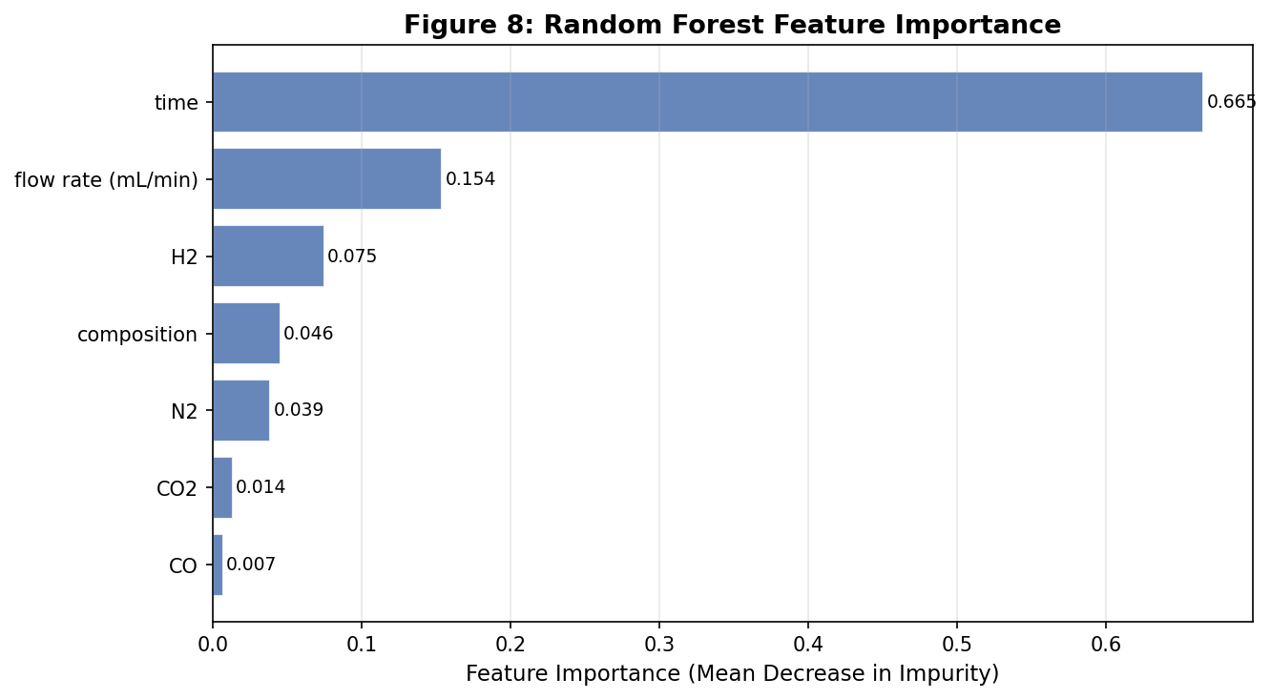
Figure 8: RF Feature Importance
- Ranks feature contributions in RF.
- Improves interpretability for operations.
- Guides future feature engineering.
All values and figures are generated from scripts/syngas_analysis.py
Kansas State University | CIS 732/830 | Figure

Slide 11
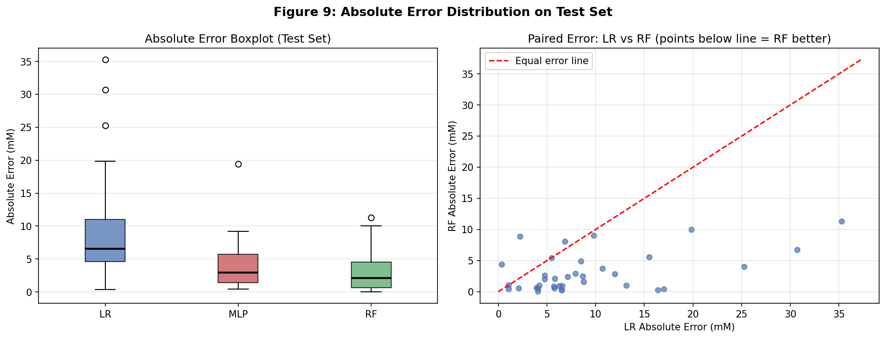
Figure 9: Error Comparison
- Compares test-set error distributions.
- Paired sample view supports hypothesis testing.
- RF errors are generally lower than LR.
All values and figures are generated from scripts/syngas_analysis.py
Kansas State University | CIS 732/830 | Figure

Slide 12
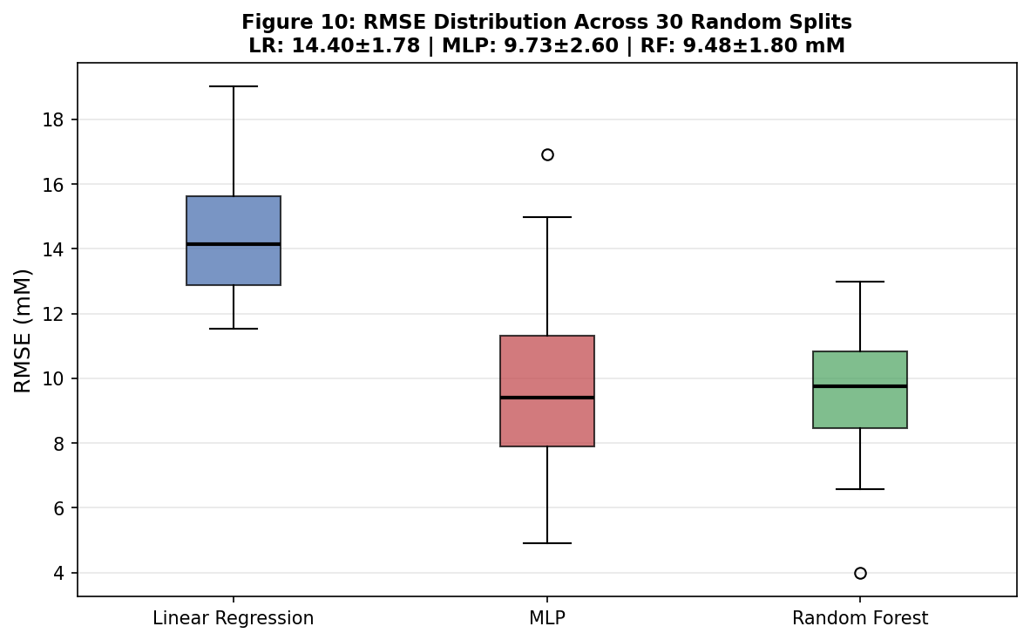
Figure 10: Robustness Boxplot
- RMSE distribution over 30 random splits.
- Measures stability beyond one split.
- RF remains most stable overall.
All values and figures are generated from scripts/syngas_analysis.py
Kansas State University | CIS 732/830 | Figure

Slide 13
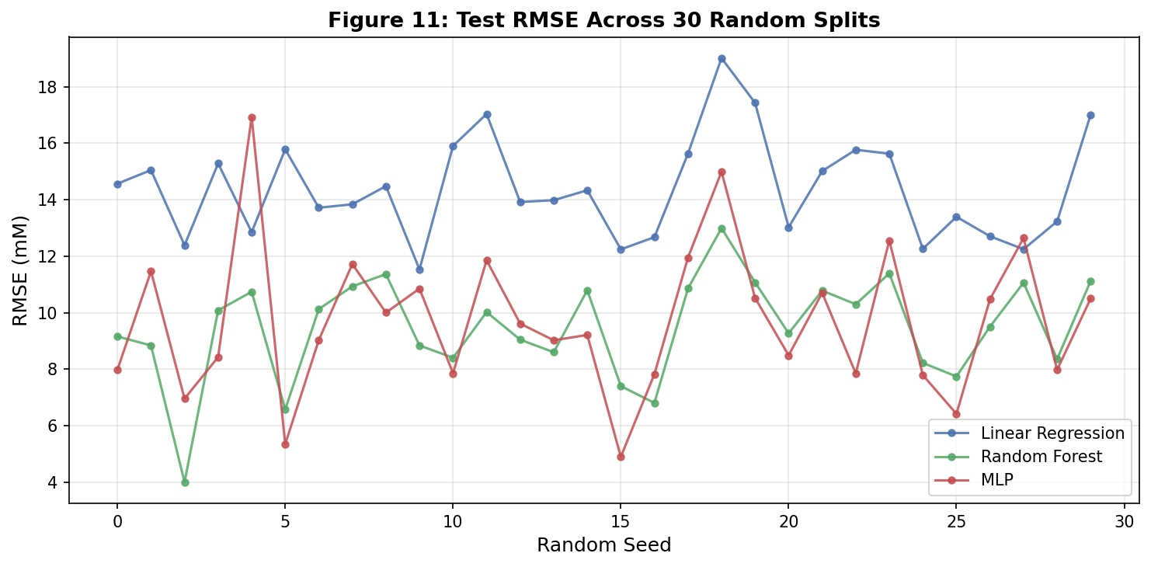
Figure 11: Robustness Across Seeds
- Seed-level RMSE trajectories by model.
- Shows variance behavior directly.
- Complements Figure 10 statistics.
All values and figures are generated from scripts/syngas_analysis.py
Kansas State University | CIS 732/830 | Figure

Slide 14
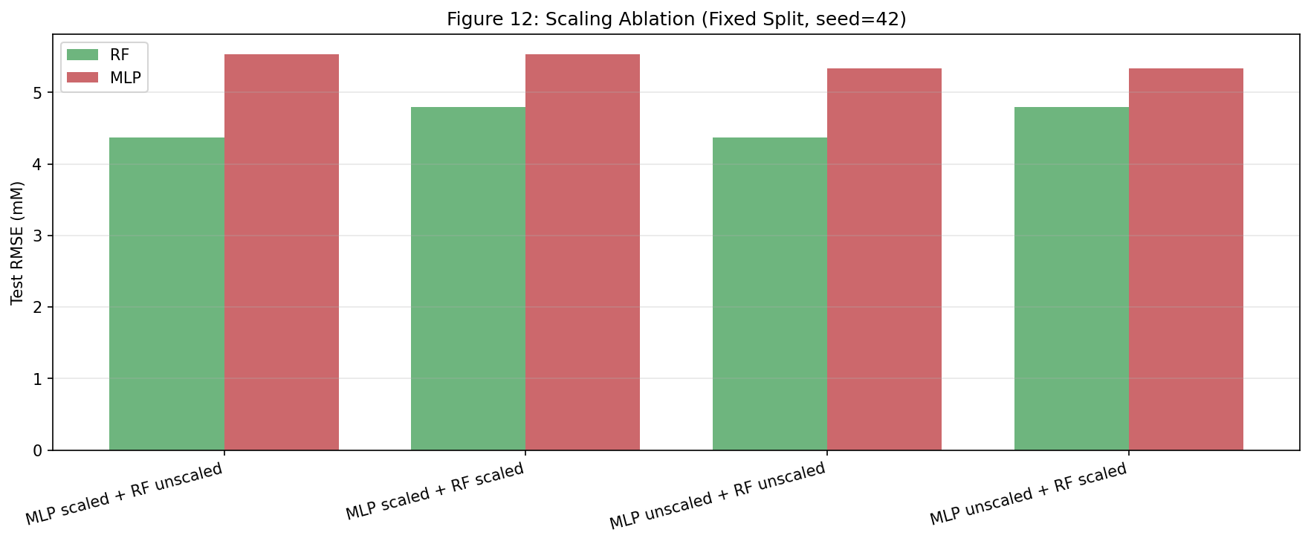
Figure 12: Scaling Ablation (4 Combinations)
- Tests all required scaler on/off combinations.
- RF unscaled performs best in this dataset.
- Documents preprocessing impact explicitly.
All values and figures are generated from scripts/syngas_analysis.py
Kansas State University | CIS 732/830 | Figure

Slide 15
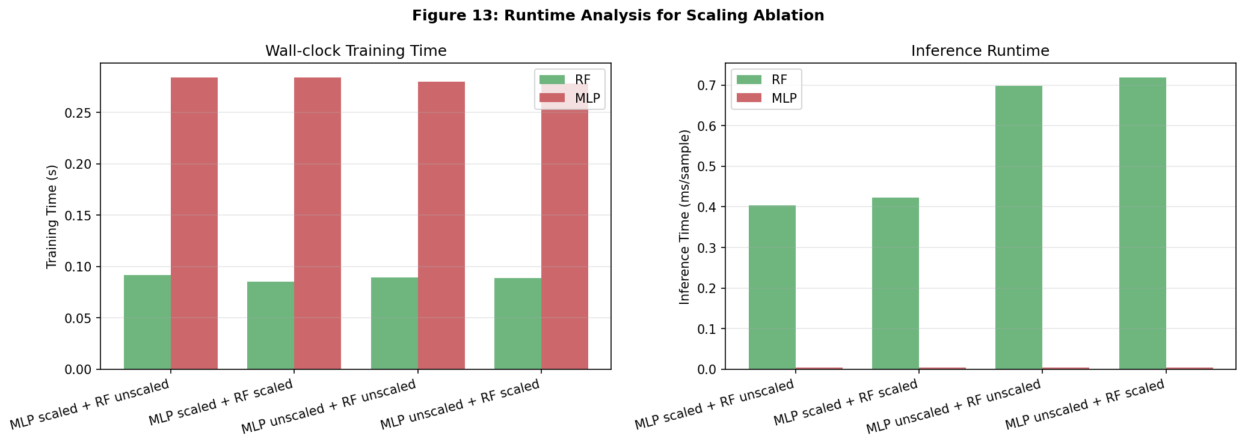
Figure 13: Runtime Analysis
- Wall-clock training and inference comparison.
- Inference is sub-millisecond per sample.
- Runtime is acceptable for deployment.
All values and figures are generated from scripts/syngas_analysis.py
Kansas State University | CIS 732/830 | Figure

Slide 16
Conclusion and Recommendation
Random Forest is selected as the primary model for this dataset.
Best fixed-split result: RF RMSE=4.3706, R2=0.9529
30-split robustness supports stable generalization.
Scaling ablation and runtime analyses were fully completed.
Significance confirmed: t-test p=2.79e-06, Wilcoxon p=3.02e-06
Final recommendation: deploy RF first, keep MLP for future extensions.
Kansas State University | CIS 732/830 | Conclusion

